Slide 1
CSE 111 Project Phase 1
https://github.com/jlopezhernandez7/CSE-111
Jose Lopez Hernandez and Emanuel Marin

Slide 2
Bobcat Connect: Basic Overview
A local event finder app
The goal is for students using the app to be able to connect on campus with others who share the same interests or hobbies.

Slide 3
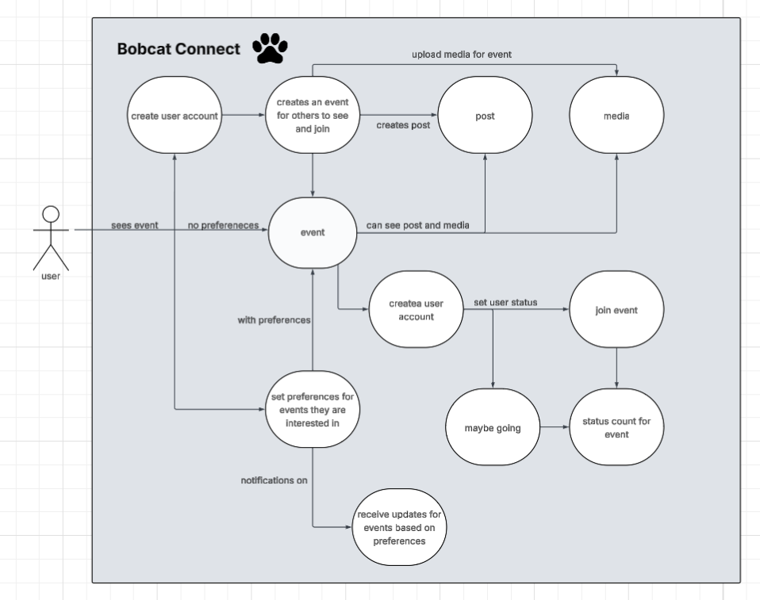
Use Case Diagram

Slide 4
Use cases: Host
-As a host I want to create my own event and have others find my event and join me
-As a host I want to upload media and post updates on my event

Slide 5
Use Cases: user
-As a user I want to search for events, find the ones im interested in joining and set my status
-As a user I want save my preferences in order to filter the events i’m interested and be notified when those events are available

Slide 6
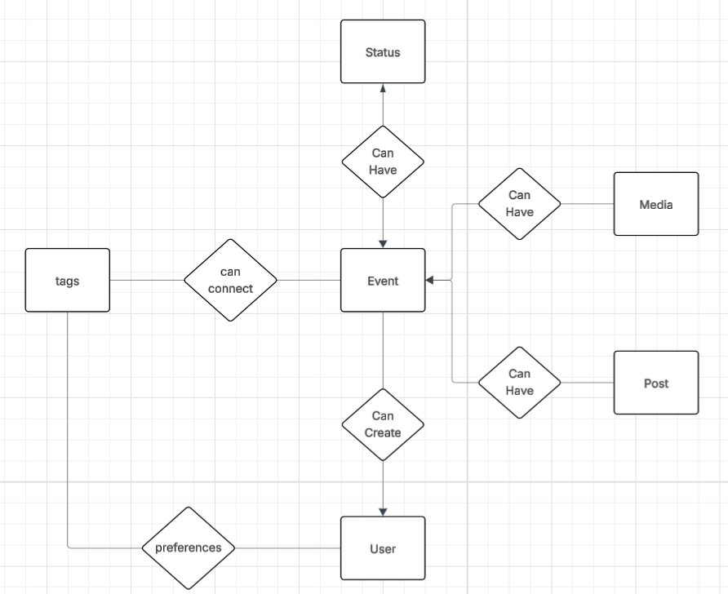
E/R Diagram

Slide 7
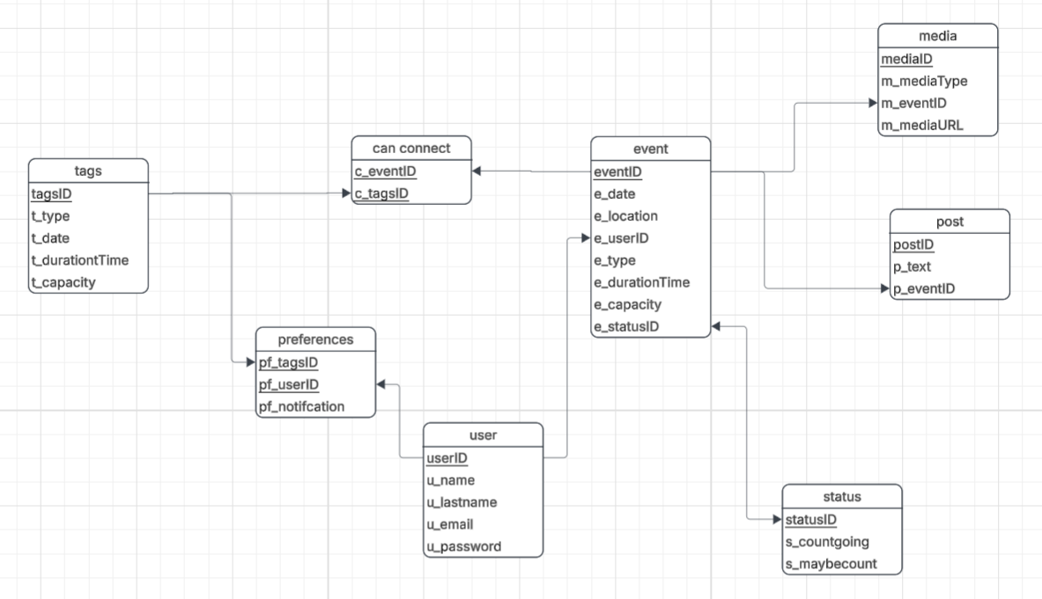
Schema

